Slide 1


Studo Spatial OS
The Universal Simulation & Discovery Engine
Vision: Free, accessible, and immersive learning for everyone.
Goal: Revolutionize education through interactive 3D holographic simulations.

Slide 2

The Core Vision - What is Studo?
Studo is a groundbreaking platform designed to provide a **free and open-source spatial computing environment** for education and research. It allows users to interact with complex 3D models, perform scientific experiments, and access a vast knowledge base through intuitive gestures and AI-powered assistance.
Key Features:
Recursive 3D model exploration
AI-driven analysis
Gesture control
Multi-device accessibility

Slide 3
The Problem We Solve
Challenges in Traditional Learning:
Studo's Transformative Solution:
Traditional learning methods often lack interactivity and accessibility, especially for complex scientific and engineering concepts. Expensive software and hardware create significant barriers for students, particularly in underserved communities.
Studo aims to break these barriers by offering a powerful, free, and universally accessible learning tool that fosters deep understanding and engagement.
Studo's Solution: Free, intuitive, immersive, and universally accessible.
Barriers: Cost, complexity, lack of engagement.

Slide 4

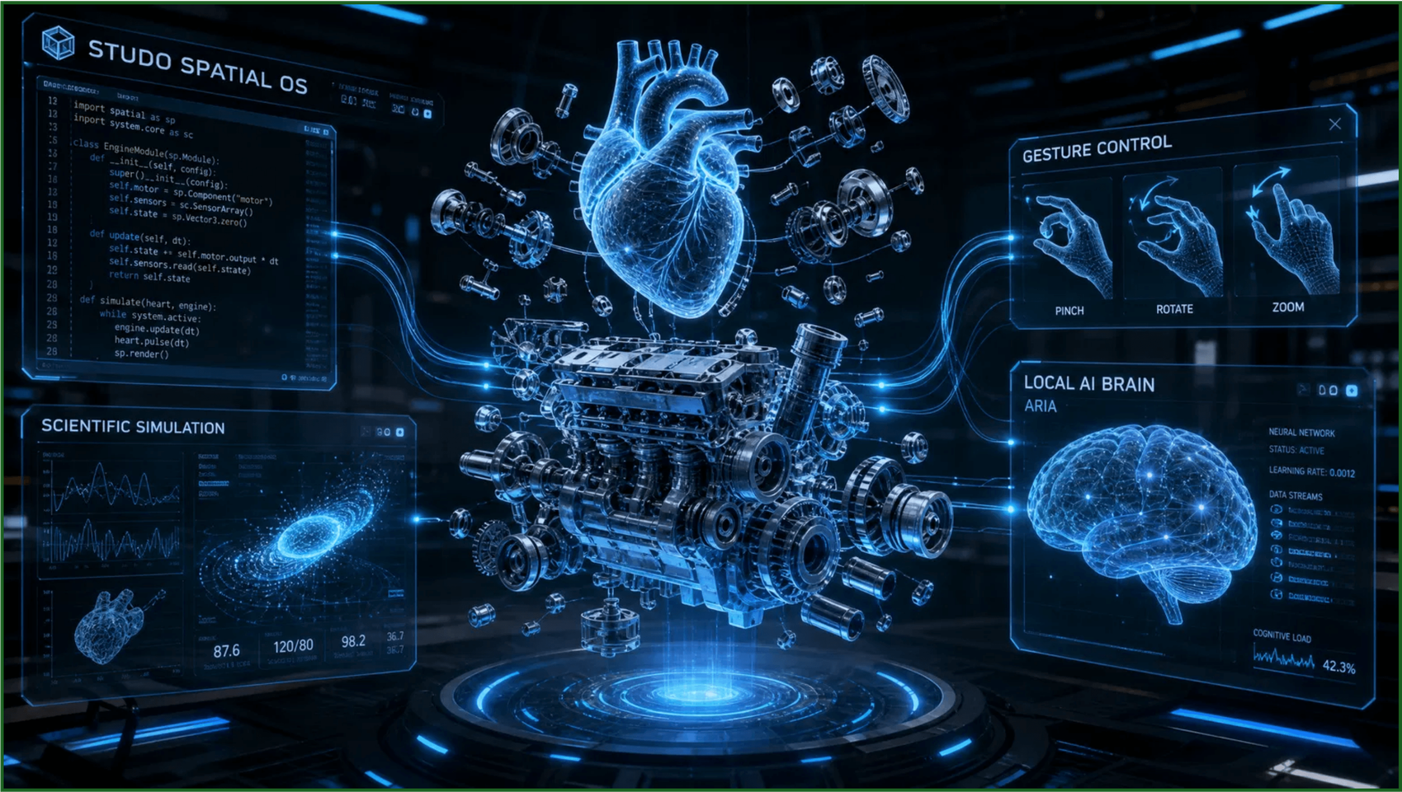
Futuristic Architecture at a Glance
This diagram illustrates the core components of Studo Spatial OS, highlighting the seamless integration of 3D visualization, AI processing, and intuitive user interaction.

Slide 5





Frontend: The Immersive Experience
TECHNOLOGY STACK
CORE FUNCTIONALITIES
3D Holographic UI
React & Vite
Glassmorphic, neon-accented spatial interface designed for depth and clarity.
Three.js (R3F)
MediaPipe Hands
Tailwind CSS
Recursive 3D Models
Deep-zoom exploration of complex structures like the human body or mechanical engines.
Gesture Control
Natural hand movements (pinch, rotate, explode) for intuitive model manipulation.

Slide 6





Backend: The Intelligent Core
Python
FastAPI
Socket.io
Real-time Communication
Bidirectional data flow between frontend and backend for seamless, low-latency interaction during simulations.
Logic
Scrapers
AI Brain Orchestration
Manages requests to the local LLM, coordinating knowledge retrieval and scientific analysis.
Simulation Engine
Processing
Sync
Processes physics and mathematical calculations to predict experimental outcomes in real-time.
The backend acts as the central nervous system, connecting user gestures to scientific knowledge.

Slide 7

The Local AI Brain (ARIA)
No API Keys, No Limits, Total Privacy
Core Engine
Contextual Understanding
ARIA processes user queries with deep awareness of the active 3D model's metadata and spatial state.
Ollama + Llama 3 / Mistral
By running high-performance Large Language Models locally, Studo eliminates dependency on expensive cloud APIs, ensuring the platform remains free for every student forever.
Scientific Analysis
Performs real-time reasoning based on physics, chemistry, and biology principles to predict simulation outcomes.
Knowledge Retrieval
Automated scraping of ArXiv and scientific databases to provide evidence-based answers and summaries.
Voice Interaction
Integrated natural language processing for hands-free control and interactive verbal guidance.
*Designed for high-performance inference on consumer-grade hardware.

Slide 8

3D Model & Image Generation: The "Murtikar" Approach
The "Murtikar" (Sculptor) approach focuses on high-fidelity 3D generation that mimics the precision of a master craftsman. By leveraging state-of-the-art generative AI, Studo creates detailed 3D meshes from simple text or 2D references.
Stable Diffusion XL (SDXL)
Generates high-resolution, photorealistic 2D textures and reference images for the 3D pipeline.
This allows for Dynamic Model Creation, where missing components or experimental variations are generated on-the-fly, providing an unparalleled visual learning experience.
Gaussian Splatting & Zero-1-to-3
Advanced techniques to reconstruct 3D geometry from 2D views, enabling rapid asset creation.
Visual Learning Impact
"Transforming abstract scientific concepts into tangible, interactive 3D structures for deep exploration."
Provides rich, accurate visual representations that help students visualize the invisible.

Slide 9




Audio & Voice: Natural Interaction
Natural Voice Output
AI-generated responses are converted into high-quality, human-like speech, providing an immersive and interactive learning experience.
The Technology Stack
Piper TTS: A fast, local text-to-speech engine that ensures high-quality audio without relying on cloud services.
Accurate Voice Input
Web Speech API: Utilizes native browser capabilities for robust speech recognition and basic synthesis.
Users can control the spatial environment and query the AI brain using natural voice commands, enabling a truly hands-free experience.
Offline Capability: Designed to function without an active internet connection, ensuring accessibility in all environments.

Slide 10

Multi-Device & Accessibility
PWA (Progressive Web App)
Docker & Docker Compose
A single, unified codebase that provides a native-like experience across Windows, Mac, Linux, Android, and iOS without requiring separate app store downloads.
Simplified deployment with a one-command setup. Docker ensures that the entire Studo environment—including the Local AI—runs consistently on any machine.
Lightweight Frontend
Free & Open-Source
Optimized Three.js rendering and efficient state management ensure smooth 3D performance even on low-end devices and older smartphones.
Eliminating financial barriers by removing subscription fees and paid API dependencies. Truly accessible to students and researchers worldwide.

Slide 11







Security, Debugging & Future
SECURITY & PRIVACY
STABILITY & TOOLS
Local-first data processing for 100% privacy
Sentry integration for real-time error tracking
CORS & Rate Limiting to prevent server abuse
Custom MCP for seamless AI tool orchestration
No external API dependency for core logic
Comprehensive logging for simulation accuracy
THE FUTURE OF STUDO
Collaborative Labs
Advanced Physics
Global Integration
Multi-user spatial environments for
Integration of high-fidelity fluid dynamics and
Direct sync with major educational platforms
synchronized group learning and research.
chemical reaction simulations.
and research repositories.

Slide 12

Join the Revolution!
Empowering the next generation of learners and innovators.
GitHub: github.com/Minato95-ayu/3d-holograph-study-center
Contact: ayushkaushik@studo.io
Website: www.studo.io

